Slide 1


Course: Object Oriented Programming
Abstract Classes and Interfaces
Defining What Must Be, Allowing What Can Be
Evis Plaku

Slide 2



Abstract Classes & Interfaces
Two powerful mechanisms for designing robust extensible object-oriented systems
Moving beyond concrete inheritance to contracts and architectural constraints
Preventing common design mistakes through compiler-enforced rules
Enabling code reuse while guaranteeing implementation of critical methods
Abstract
Common contract

Slide 3



The Conceptual Problem
Some classes represent concepts too abstract to exist as standalone objects
Example: Animal is a concept but "generic animal" isn't real
Example: Shape defines common properties but has no specific area
Example: Vehicle shares features but lacks concrete drive mechanism

Slide 4


The Instantiation Problem
Allowing instantiation of conceptual parent classes creates meaningless incomplete objects
Animal animal = new Animal() makes no sense without species
Shape shape = new Shape() cannot calculate area without type
Need mechanism preventing instantiation while preserving hierarchy benefits

Slide 5

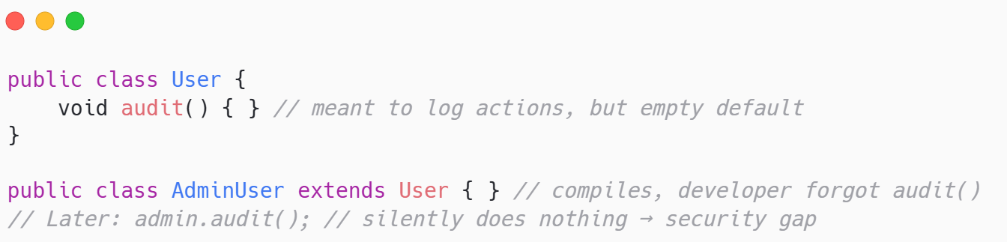

The Contract Problem
Inheritance alone cannot force subclasses to implement required methods
Developer might forget to override critical methods
Compiler accepts incomplete subclasses catching errors only at runtime
Documentation insufficient to enforce architectural requirements across team

Slide 6



The Multiple Capability Problem
Unrelated classes often need to share behaviors without common parent
Example: CreditCard, PayPal, BankTransfer all need a Payable interface(processPayment(), validate(), refund())
Example: Authentication providers GoogleAuth, LocalAuth, TokenAuth all implement Authenticatable
Cannot use inheritance; these are fundamentally different hierarchies

Slide 7


Design goals
We need mechanisms enforcing contracts enabling reuse across different hierarchies
Prevent instantiation of conceptually incomplete parent classes
Force subclasses to implement required methods at compile time
Allow unrelated classes to guarantee shared capabilities

Slide 8

The Two Solutions
Java provides abstract classes for hierarchies and interfaces for capabilities
Abstract classes Partial implementation with enforced customization points
Interfaces Pure contracts defining capabilities across hierarchies
Code reuse with flexible contracts

Slide 9
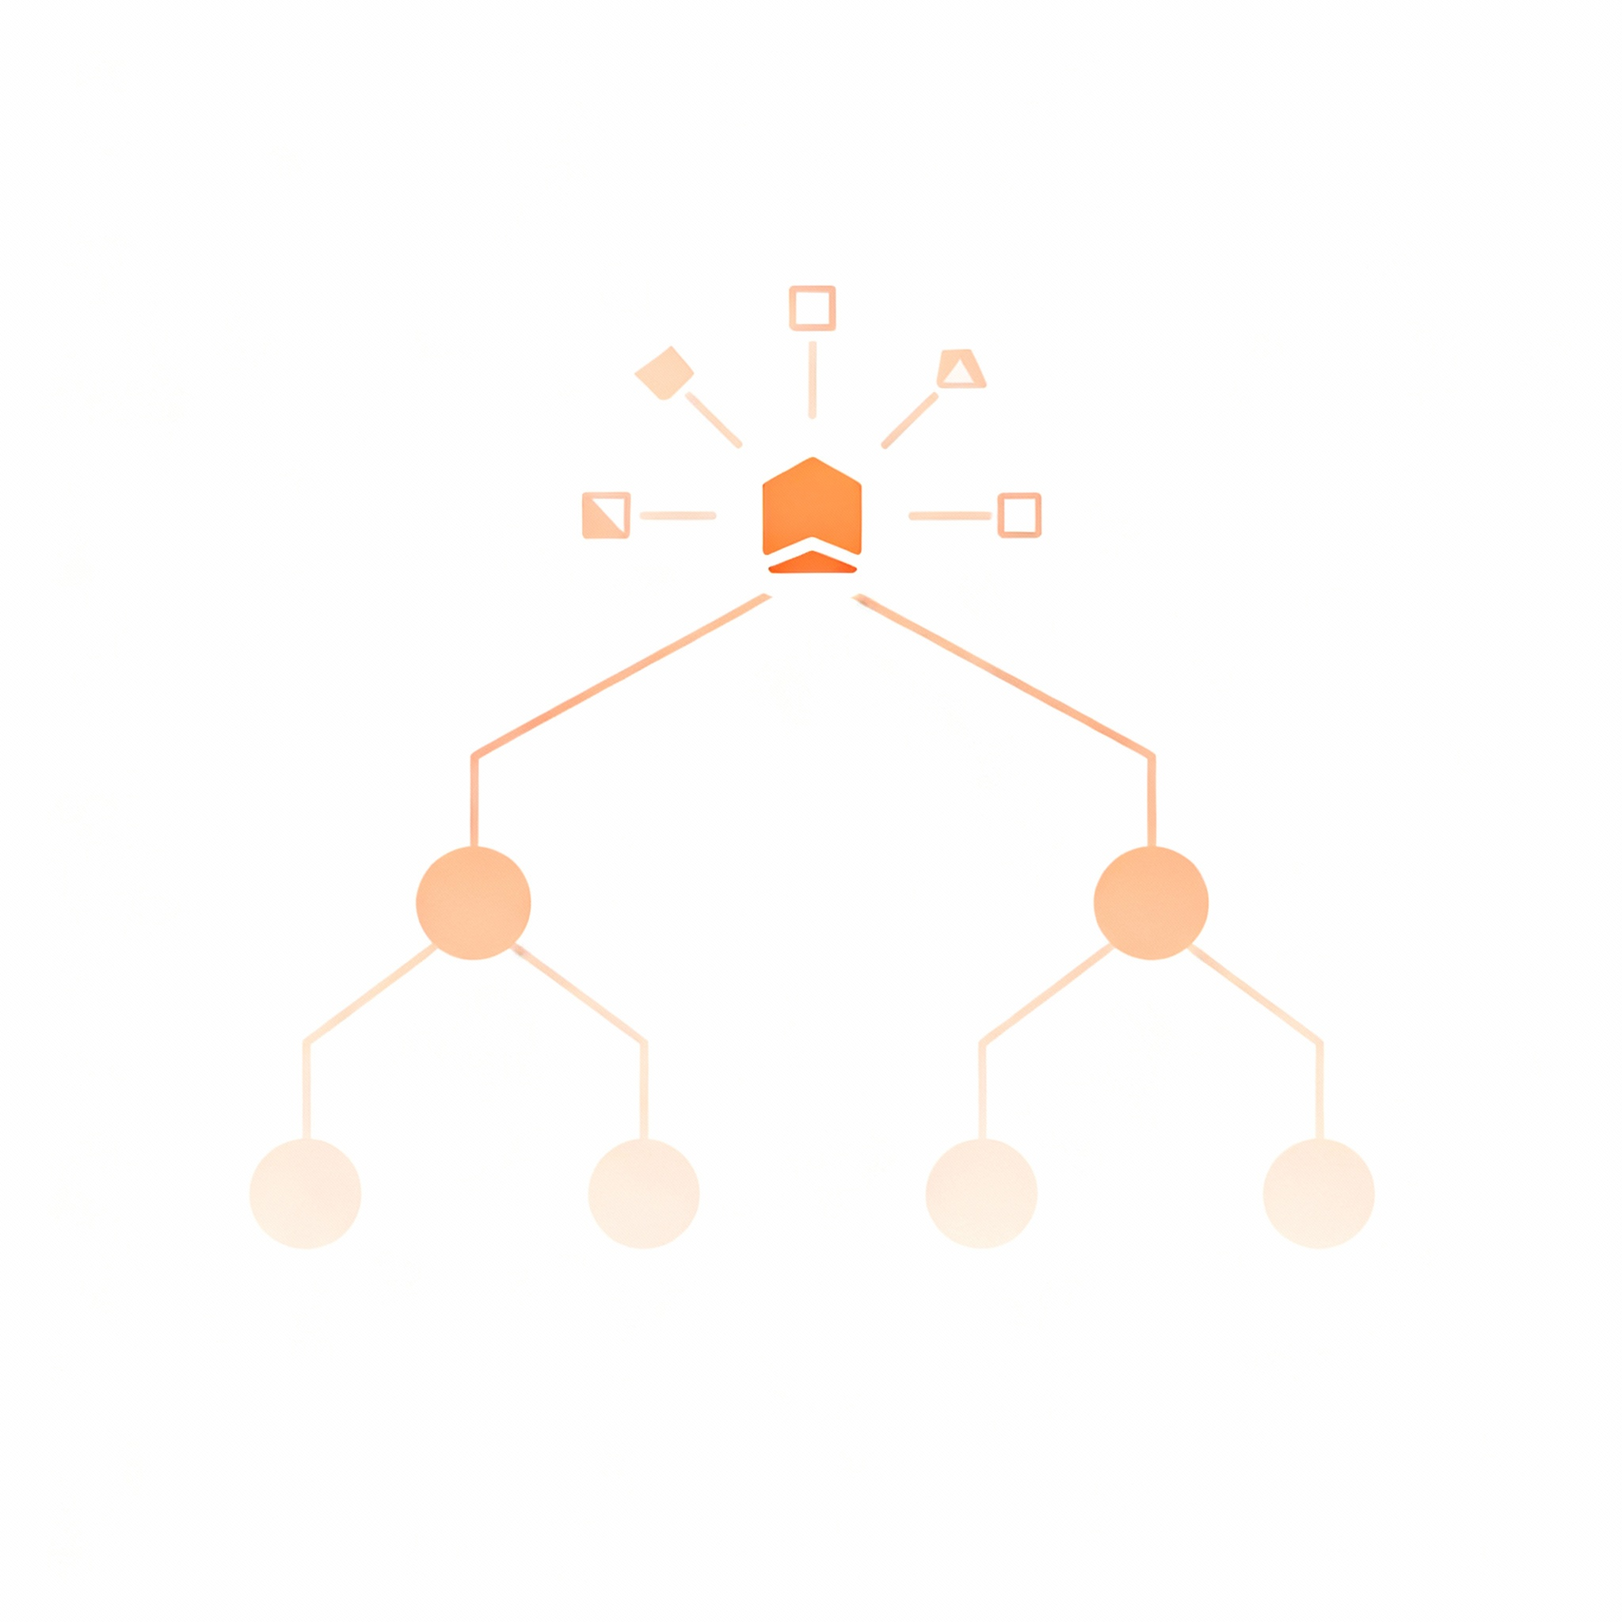
Core Concepts

Slide 10

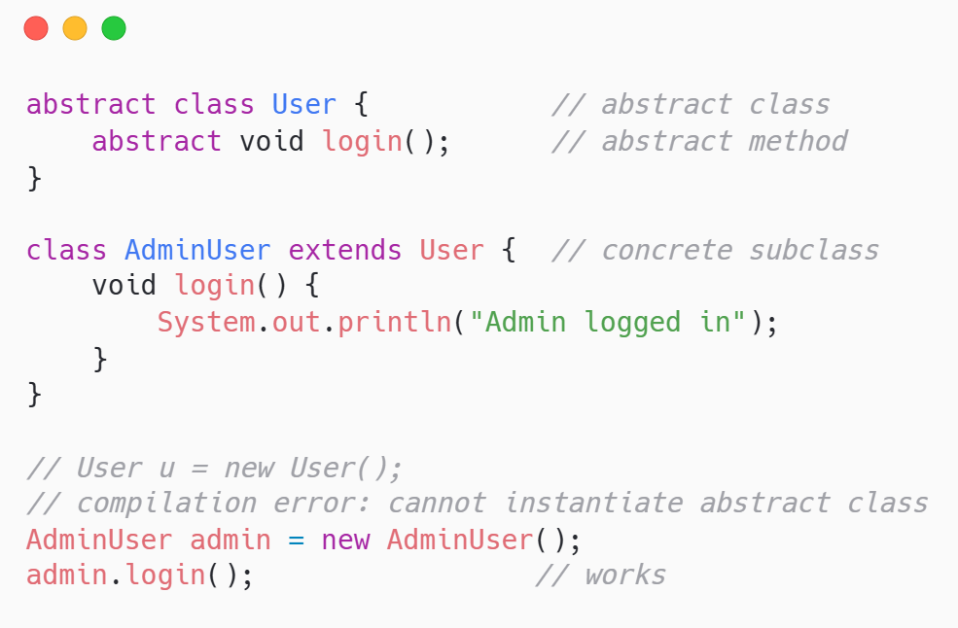
Abstract Classes Definition
Abstract classes cannot be instantiated but provide foundation for subclasses
Declared with abstract keyword
Cannot create instances, it causes compilation error
Must be extended by concrete subclasses to be useful

Slide 11

Abstract Methods
Abstract methods declare signatures without implementation forcing subclasses to provide logic
Example: public abstract double calculateSalary(); no method body
Subclasses must implement or become abstract themselves
Compiler enforces implementation preventing forgotten methods

Slide 12

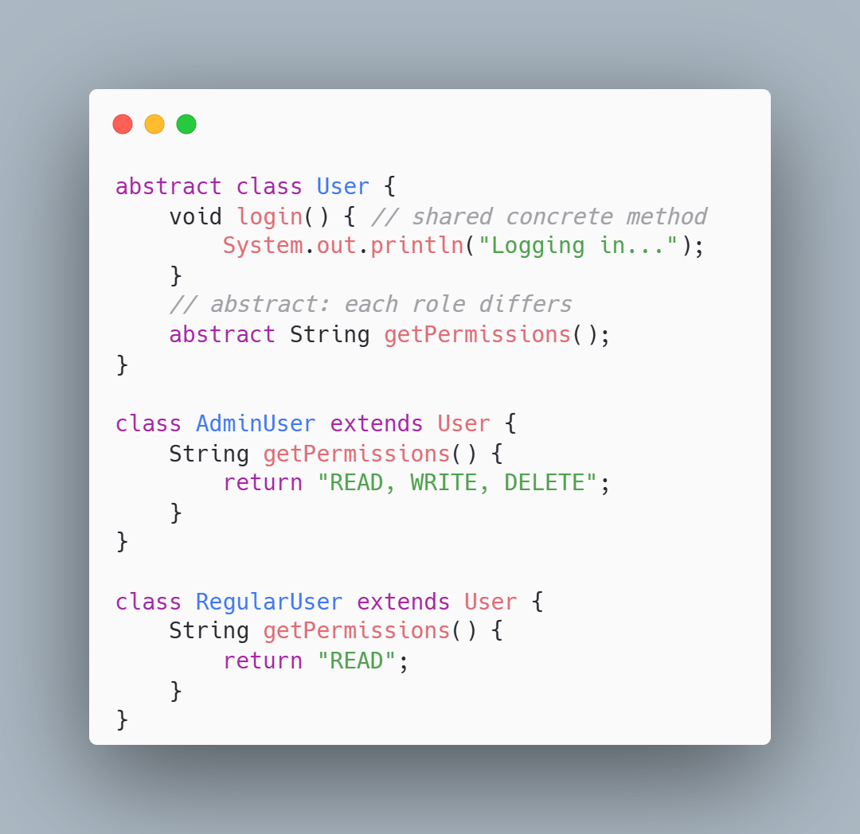
Concrete Methods in Abstract Classes
Abstract classes mix implemented methods with abstract ones enabling code reuse
Example: User has concrete login() all users authenticate similarly
Example: User has abstract getPermissions() each role differs
Subclasses inherit working code and implement only what's unique

Slide 13





University System Example
User hierarchy demonstrates abstract parent with concrete specialized subclasses
Abstract: public abstract class User {abstract String getRole();}
Concrete: Student tracks courses; Instructor manages classes; Admin controls system
Prevents meaningless generic users guarantees role identification exists
User
Student
Instructor
Admin

Slide 14

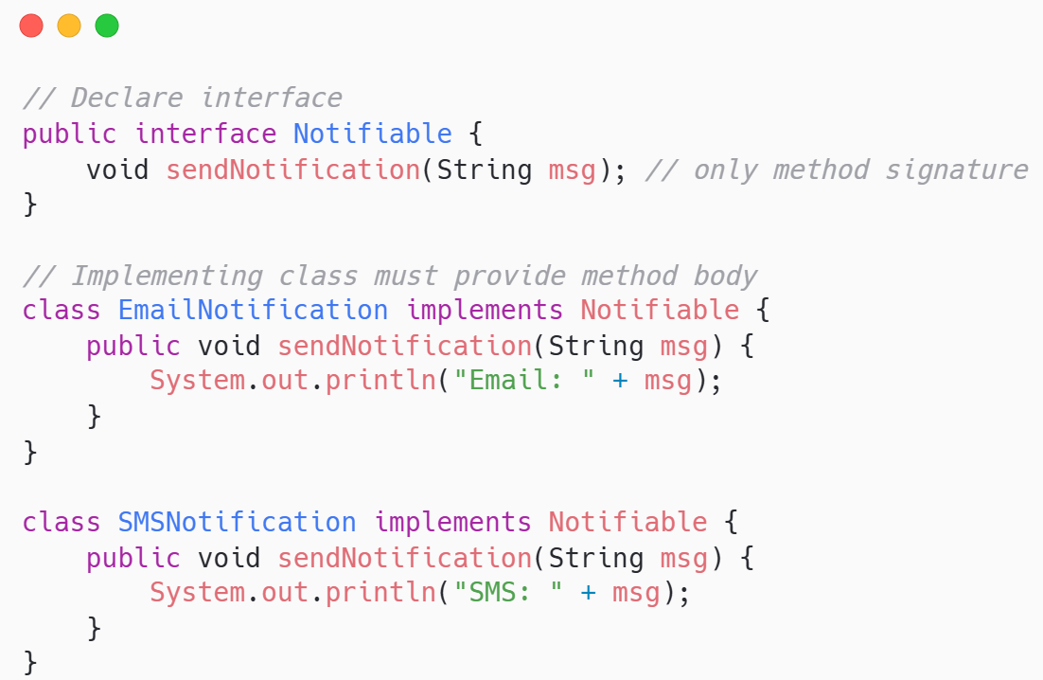
Interfaces Definition
Interfaces define pure contracts with method signatures but zero implementation
Declared with interface keyword
Contains only method signatures
Implementing classes must provide all method bodies

Slide 15

Implementing Interfaces
Classes implement interfaces using implements keyword creating contractual obligations
Syntax: public class MyClass implements MyInterface
Must implement every interface method or become abstract
Multiple interfaces allowed: class MyClass implements FirstInterface, SecondInterface

Slide 16
Abstract Class vs Interface
Abstract classes share code within hierarchies Interfaces define contracts across hierarchies
Choose based on relationship: is-a uses abstract; can-do uses interface
Abstract class: can have fields constructors, concrete methods, single inheritance
Interface: only method signatures, no state, multiple implementation

Slide 17

Abstract Class vs Interface
Abstract classes
Interfaces
When subclasses share significant code but need customization
Common implementation exists
Closely related classes form natural hierarchy
Capabilities shared across unrelated classes
Support multiple inheritance
Objects of different types need to share a behavior

Slide 18
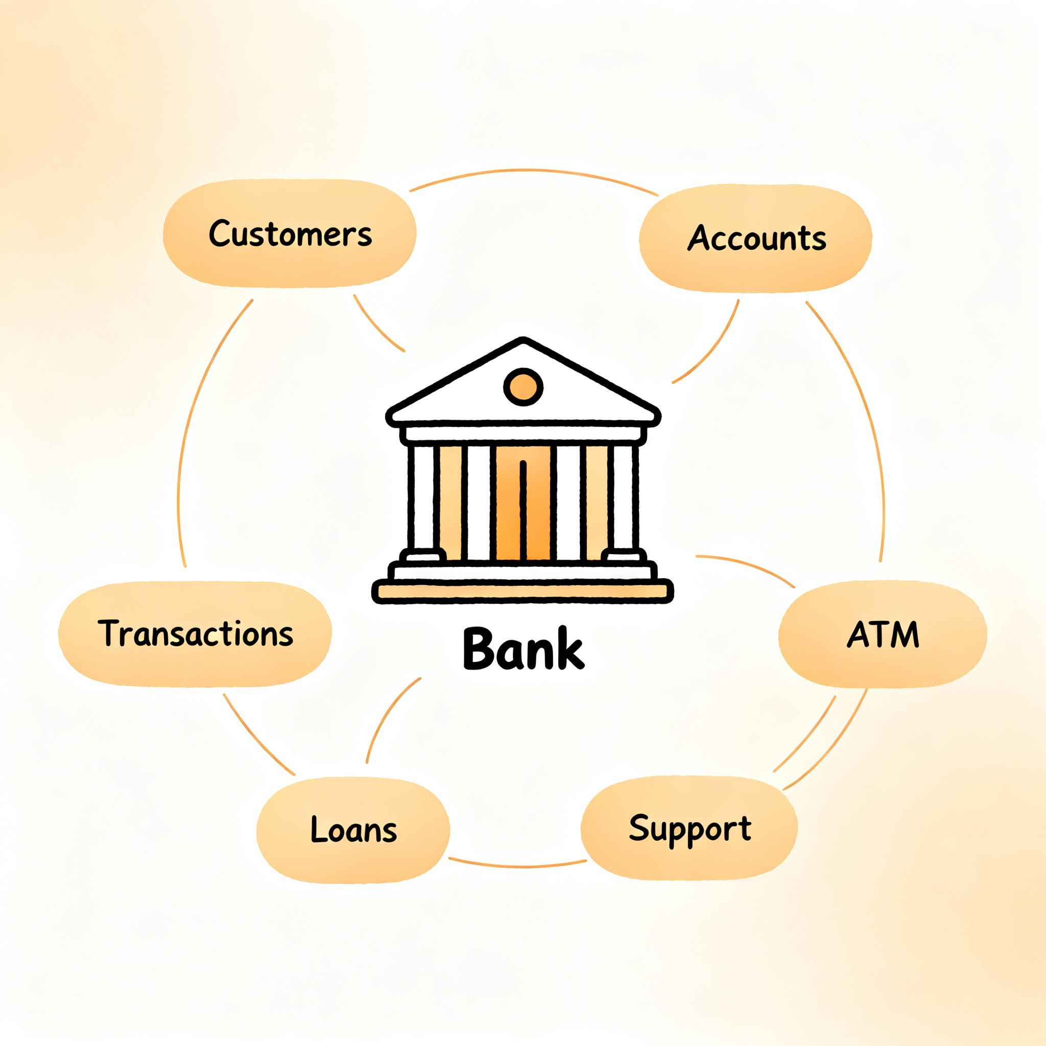
Bank System Example

Slide 19

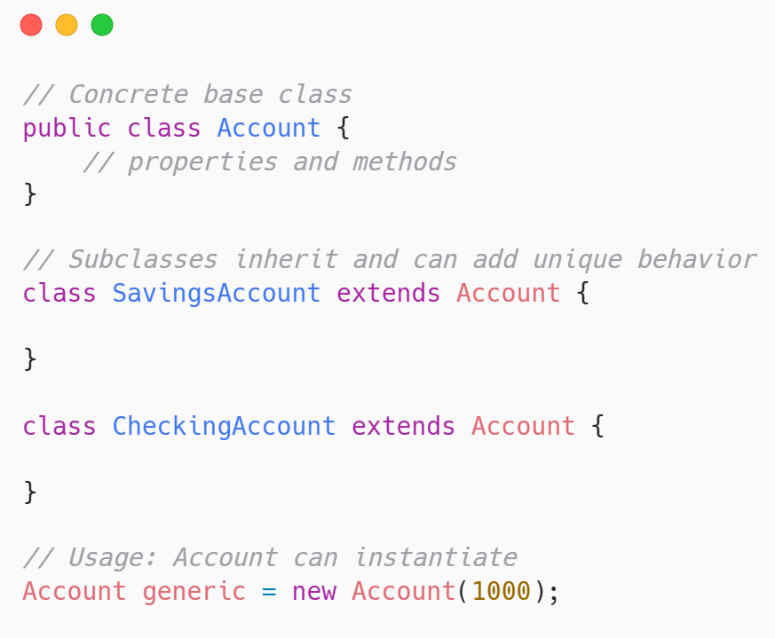
Reviewing our bank management system
Current system uses concrete Account class as parent for specialized types
Account is concrete: can instantiate generic new Account(1000)
SavingsAccount and CheckingAccount extend Account
Problem: generic accounts semantically meaningless in real banking

Slide 20

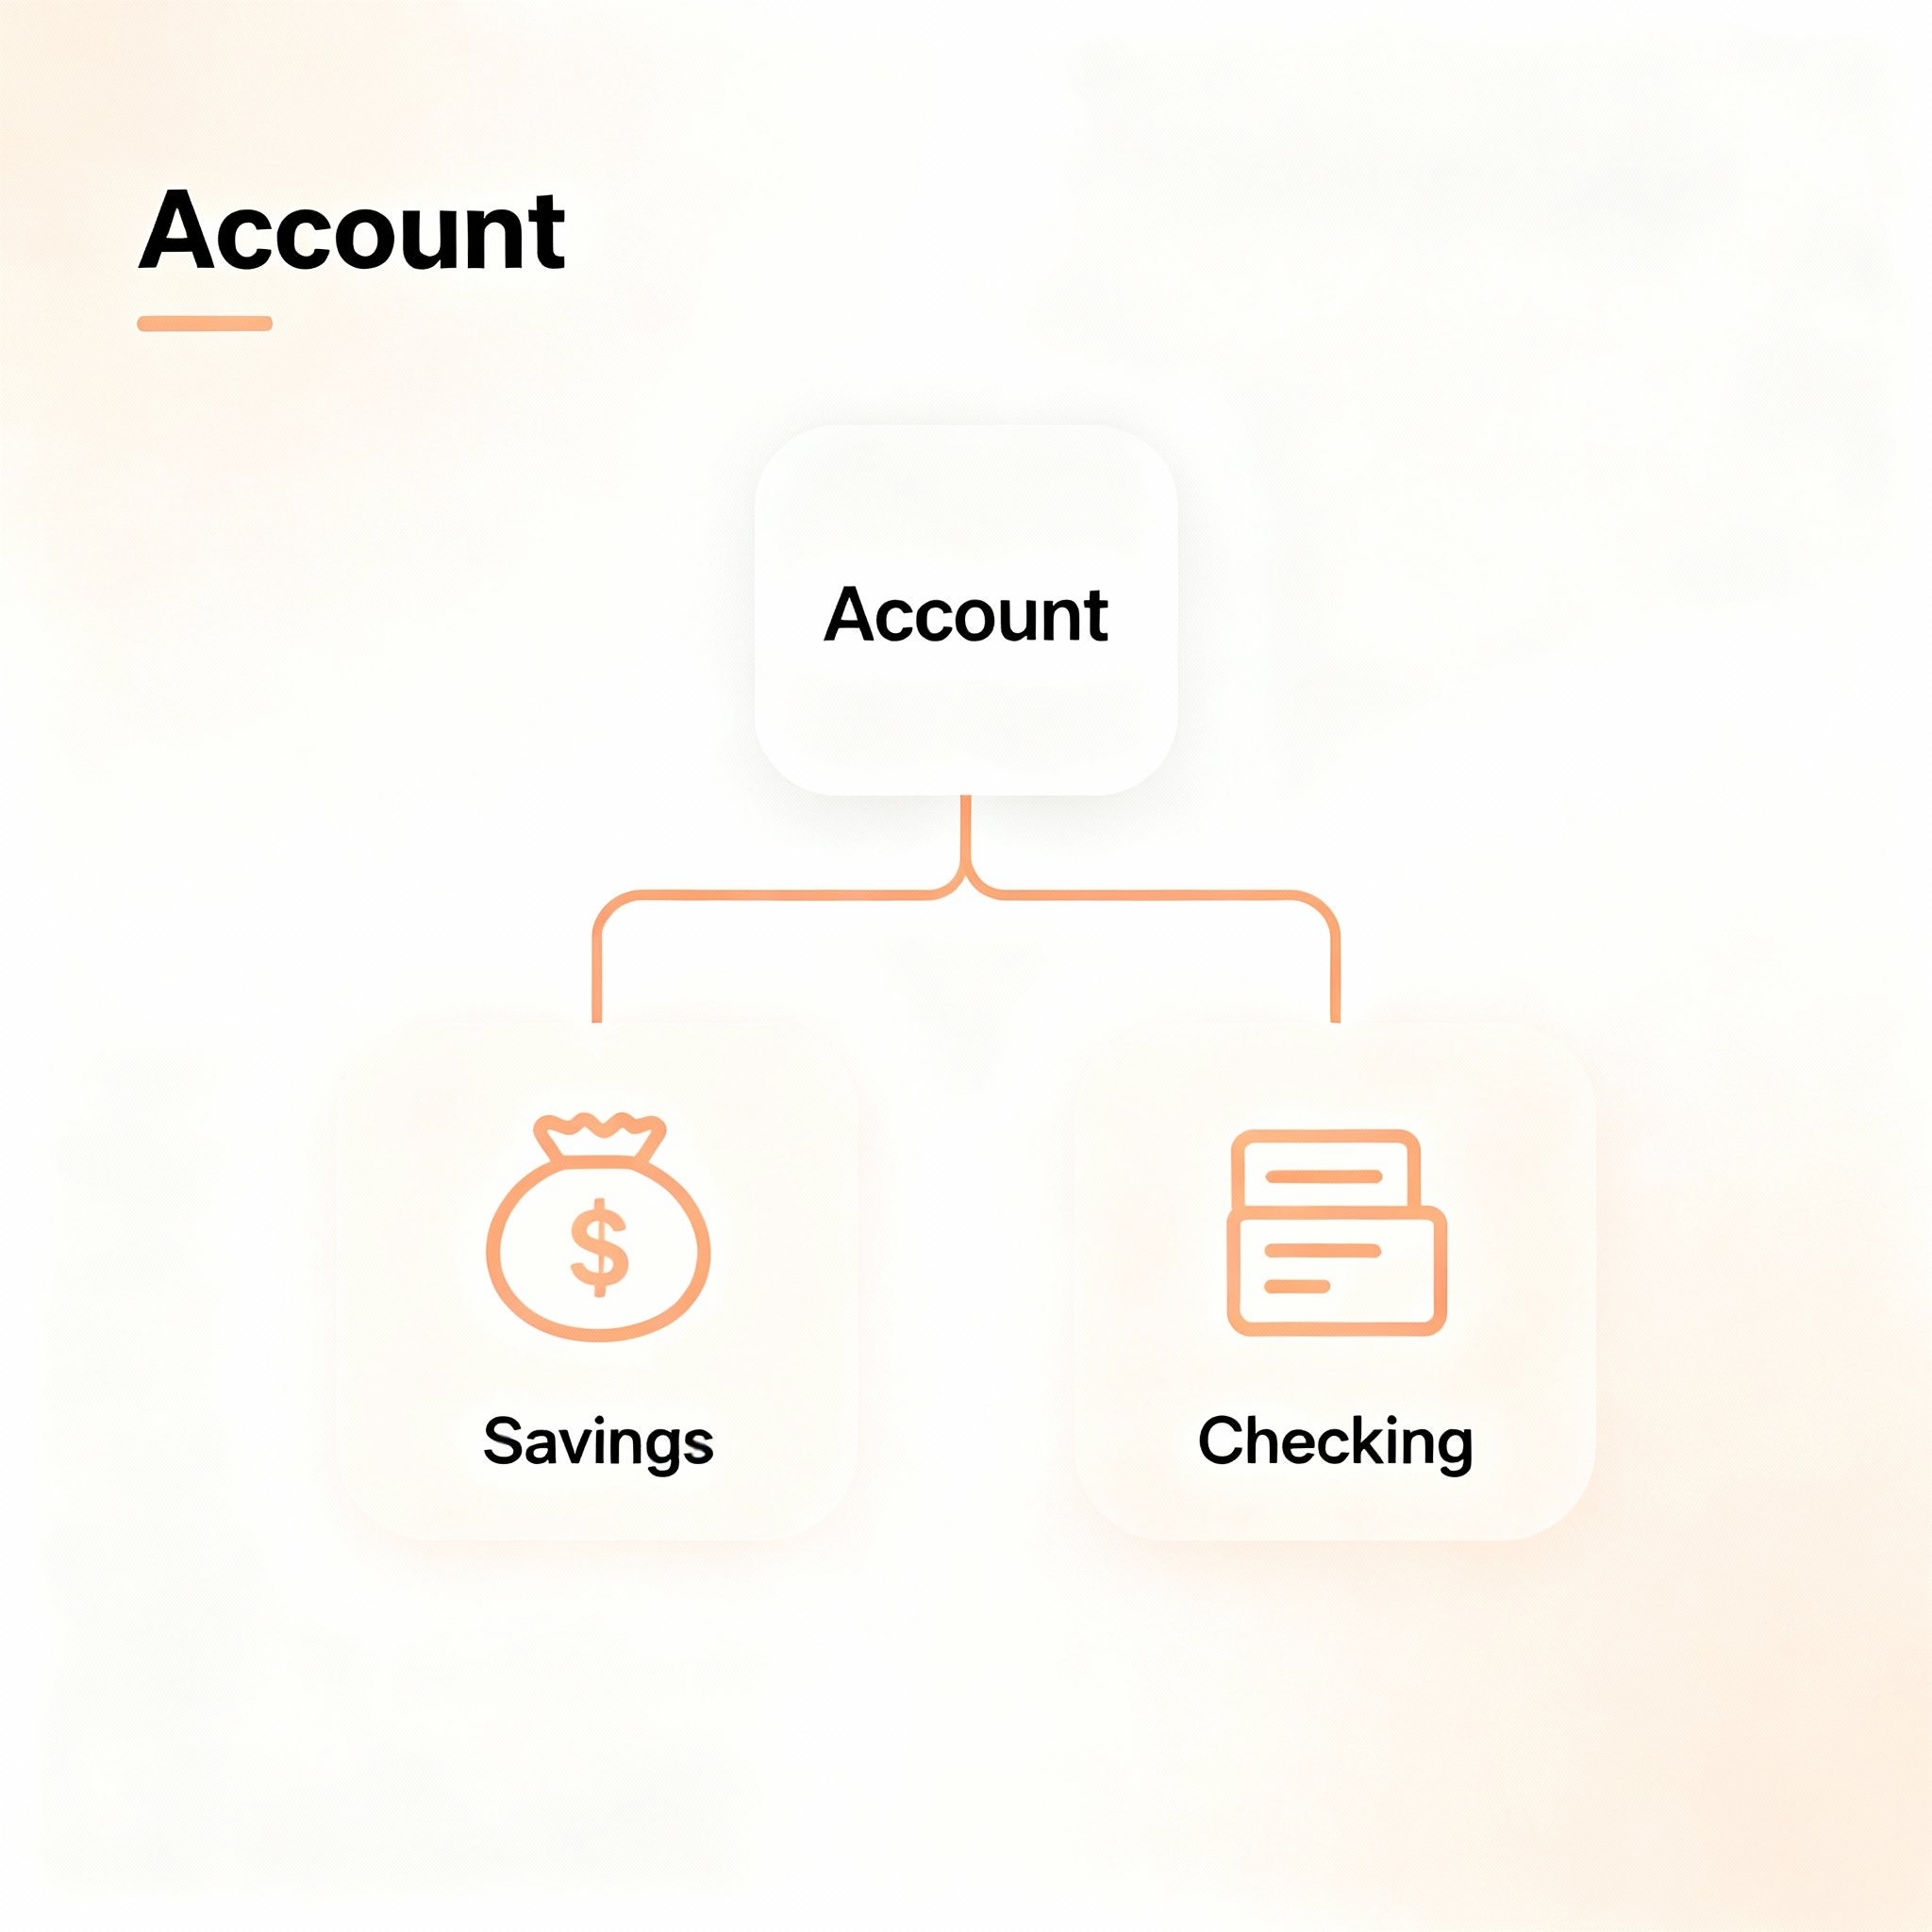

Why Account Should Be Abstract
Banks offer specific account types never generic unspecialized accounts
Real scenario: Customer must choose savings, checking or other type
Generic Account has no business rules for interest or overdraft
Making Account abstract prevents creating meaningless generic accounts
No need for generic object

Slide 21
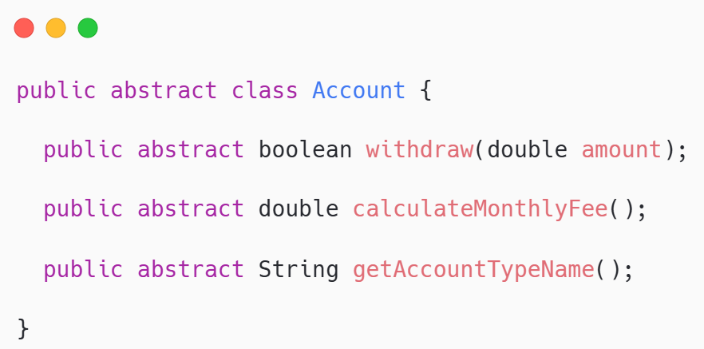
Making Account Abstract
Adding abstract keyword prevents instantiation while preserving inheritance benefits
Before: we allow generic class
After: we force accounts to be checking, saving, or any other type
All shared code remains; subclasses inherit working implementations

Slide 22

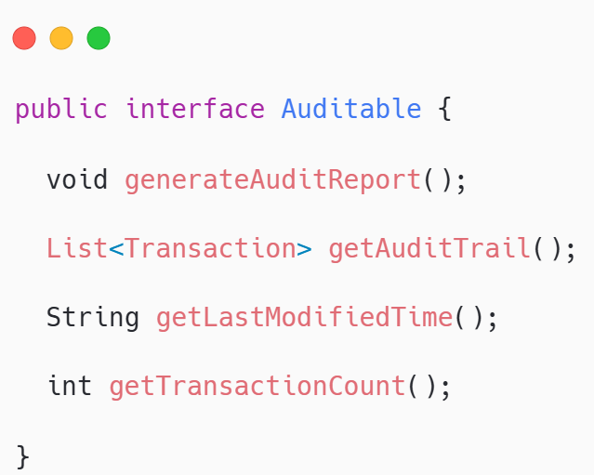
The Auditable Interface
Multiple classes need audit capabilities without being in same hierarchy
Account needs transaction history auditing
Bank needs operation logging Customer needs change tracking
Different hierarchies same capability: perfect for interface

Slide 23



Polymorphism Benefits
Both abstractions enable powerful polymorphic code working with contracts
Abstract class: Account a = new SavingsAccount() works perfectly
Interface: Auditable item = account; item.generateAuditReport();
Code depends on abstractions not concrete implementations

Slide 24

Key takeaways
Abstract classes and interfaces transform good designs into bulletproof architectures
Abstract classes
Interfaces
Abstract classes: prevent incomplete instantiation, share code, and enforce customization
Interfaces: define cross-hierarchy capabilities and support multiple implementation

Slide 25


Quote of the week
Stay concrete in your values Stay flexible in your implementations

